Slide 1
Is remote monitoring possible soon in EP?
가톨릭의대 서울성모병원
김 성 환

Slide 2
Yes

Slide 3
The objects of Remote monitoring (1)
Vital signs
  Transmission of data and health coaching telephone calls
Lung congestion
  technically feasible in all current CIED. But, low sensitivity (20-30%)

Slide 4
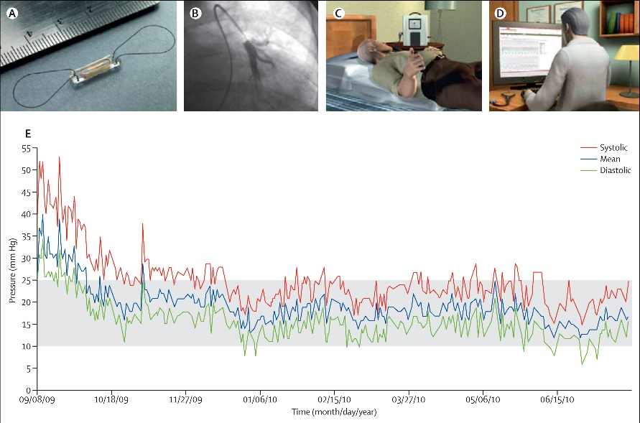
The objects of Remote monitoring (2)
Hemodynamic
  CHAMPION-HF trial (Pulmonary artery, CardioMEMS®)

Slide 5
CIED remote monitoring service in US
Since 2006!
  Biotronik: Home MonitoringTM
  Boston: LATITUDETM
  Medtronic: CARELINKTM
  Abbott: MerlinTM
  Sorin: SMARTVIEWTM

Slide 6
Comparison of monitoring systems
 | Sorin | Biotronik | Medtronic | Boston | Abbott
Transmitter | Stationary | Mobile | Mobile | Stationary | Stationary
Physician notification | Fax, email, SMS | Fax, email, SMS | email, SMS | Fax, phone | Fax, email, SMS
Feedbackto patients | LED | LED or call to clinic | LED or call to clinic | Text, audio messages | LED, automated phone calls

Slide 7


Remote patient management
Remote Follow-up
Device interrogation that provides similar data to
in-clinic follow-up visits
Remote Monitoring
Additional device and patient monitoring between scheduled follow-ups
Designed to minimize patient & clinic burden
Designed to see changes sooner
Patient Initiated Interrogations (PII)
On-demand interrogation of device (Clinic configures feature via website)
Designed to see data sooner

Slide 8
Transmission success by technology (1)
Tarakji et al. Heart Rhythm 2021

Slide 9
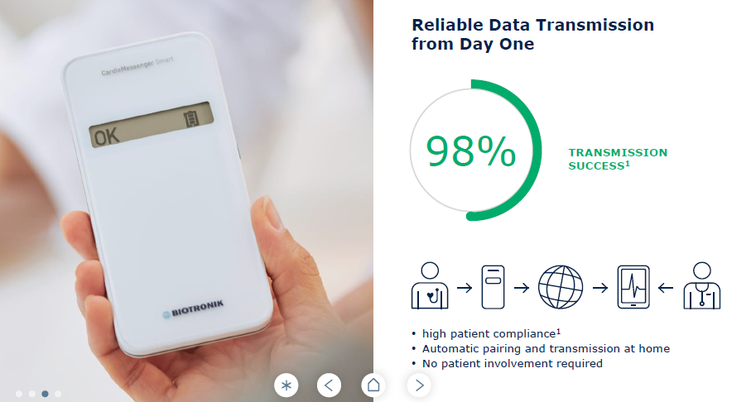
Transmission success by technology (2)

Slide 10
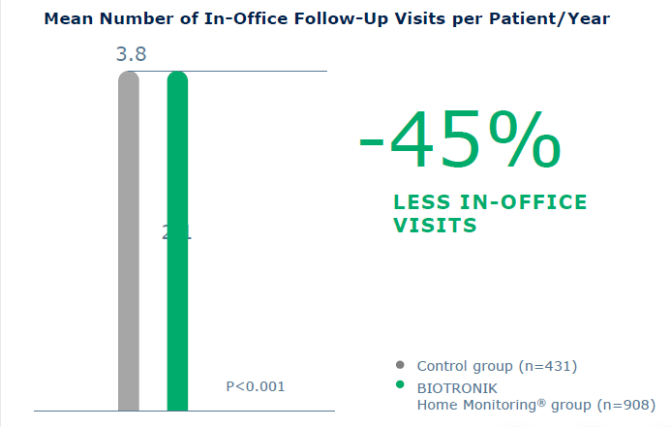
Reduction of In-Office Visits
TRUST trial. Circulation 2010

Slide 11
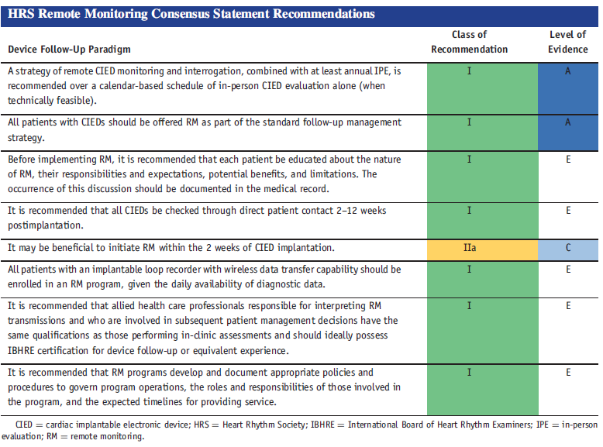
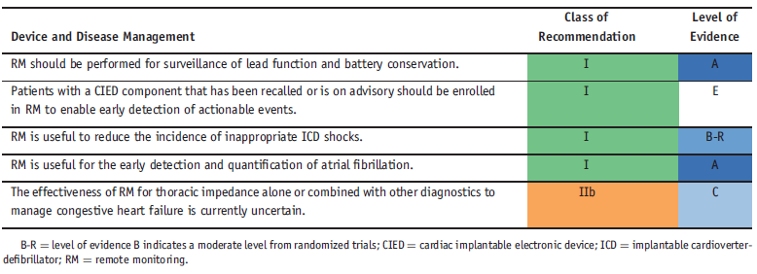
HRS Recommendation on RM (2015)

Slide 12
Ongoing RCT (1)
Study title | Description | N | Completion date | Primary outcome
EMPOWER | Electronic pill bottle for diuretic and a Bluetooth scale conditional on medication adherence and registering a weight measurement. | 566 | March 2021 | Readmission at 12 m
HERMeS | Remote daily telemonitoring and remote follow-up audio/video conference. | 508 | Aug 2021 | CV death or non-fatal HF events at 6 m
HF-eVOLUTION | Biobeat wrist watch for continuous measurement and reporting of blood pressure data and with a smartphone to report weight. | 120 | Sep 2021 | daily dose-related medication score, GDMT at 6 m
ECOST-CRT | Remote notification of HF parameters, atrial arrhythmias and patient’s symptoms and signs. | 652 | Apr 2022 | death from any cause and hospitalisation at 27 m

Slide 13
Ongoing RCT (2)
Study title | Description | N | Completion date | Primary outcome
Daily Ambulatory Remote Monitoring System For Post-Discharge Management Of ADHF (DAVID-HF) | Remotely collected physiological data obtained from home-based and wearable devices. | 876 | July 2022 | rehospitalisation and/or mortality at 12 m
Effects of Remote Monitoring of Patients With Heart Failure Based on Smartphone Application (ERICA-HF) | Remote monitoring with a mobile application which will assess dyspnoea, position in bed, oedema, weight change, blood pressure and heart rate. | 300 | Dec 2023 | Number of hospitalisations at 12 m
Multiple Cardiac Sensors for the Management of Heart Failure (MANAGE-HF) | Remote monitoring of S1 and S3 heart sounds, night-time heart rate, thoracic impedance and respiration from the HeartLogic feature of implanted CRT-D or ICD devices. | 2700 | Jan 2025 | All-cause mortality and HF hospitalisation after 4 years.

